Slide 1


ANALYSIS OF AIR QUALITY USING MACHINE LEARNING ALGORITHMS
Priyadharsini V |  | 160501113
DOMAIN: | Machine Learning,
Date of Review | 29-10-2019

Slide 2
Abstract - Analysis of Air Quality
Monitoring air quality has become one of the most essential activities in many areas today. The quality of air is adversely affected due to various forms of pollution caused by transportation, electricity, fuel uses etc. The deposition of harmful gases is creating a serious threat for the quality of life. With increasing air pollution, we need to implement efficient air quality monitoring models which collect information about the concentration of air pollutants and provide assessment of air pollution in each area. Hence, air quality evaluation and prediction has become an important research area.

Slide 3
PROBLEM STATEMENT

Slide 4
Problem Statement
.
The air pollution is one of the main causes of death in the world. Several cities are on the radar of WHO, which are about to touch the dangerous level. Sadly, India is one of the countries with maximum number of most polluted cities in the world.
To know the intricacies of the problem, we decided to do an analytical study for the factors that contribute most to air pollution.
Here we have studied the air quality data of a particular location and identified factors that lead to the rise in air pollution.

Slide 5
INTRODUCTION

Slide 6
Introduction
1. Air Quality Analysis
Data Source: UCI repository
Objective: To develop machine learning methods to analyze the quality of air.
Existing method: Air Quality Prediction of Finite Particukate matter.
Proposed Solution:
Selects the best feature from the data
Calculate the monthly gases distribution
Picks the most influencing gas

Slide 7
Introduction
Supervised learning is the machine learning task of learning a function that maps an input to an output based on example input-output pairs.
It infers function from labeled training data consisting of a set of training examples. In supervised learning, each example is a pair consisting of an input object (typically a vector) and a desired output value (also called the supervisory signal).
A supervised learning algorithm analyzes the training data and produces an inferred function, which can be used for mapping new examples. An optimal scenario will allow for the algorithm to correctly determine the class labels for unseen instances.

Slide 8
Introduction
Three types of classification algorithm is used in this model. The classification algorithm is used to find the accuracy rate and best fit of the parameters. The classification algorithms used here are
Linear Regression
Support Vector Machine
Decision Tree

Slide 9
Introduction
Applications of Machine Learning
Spam Detector: Our mail agent like Gmail or Hotmail does a lot of hard work for us in classifying the mails and moving the spam mails to spam folder. This is again achieved by a spam classifier running in theback end of mail application.
Database Mining for growth of automation: Typical applications include Web-click data for better user experience, Medical records for better automation in healthcare, biological data and many more.
Web Search Engine: One of the reasons why search engines like Google, Bing etc. work so well is because the system has learnt how to rank pages through a complex learning algorithm.

Slide 10
LITERATURE SURVEY

Slide 11
Literature Survey - 1
Meteorology and Atmospheric Physics
Authors: J. C. Chang,S. R. Hanna
Year of Publication: 2004
Learnings:This paper reviews methods to evaluate the performance of air quality models, which are tools that predict the fate of gases and aerosols upon their release into the atmosphere. It is important that these models be properly evaluated.
The focus of the current paper is on the statistical evaluation component. It is important that a statistical model evaluation exercise should start with clear definitions of the evaluation objectives and specification of hypotheses to be tested.

Slide 12
Literature Survey - 2
APPLYING MACHINE LEARNING TECHNIQUES IN AIR QUALITY PREDICTION
Authors: Elias Kalapanidas and Nikolaos Avouris
Year of Publication: 1999
Learnings:The AQOCs are operational units, responsible for managing monitoring networks, processing the collected information, eventually providing on-line assessment of air pollution and its short-term and long-term evolution. Great volumes of data are collected over time in these centres.
This paper focuses on applicability of machine learning algorithms in operational conditions of air quality monitoring for predicting the daily peak concentration .

Slide 13
Literature Survey - 3
A Machine Learning Approach for Air Quality Prediction: Model Regularization and Optimization
Authors: Dixian Zhu, Changjie Cai,Tianbao Yang,Xum Zhou
Year of Publication: 2018
Learnings: In this paper, we tackle air quality forecasting by using machine learning approaches to predict the hourly concentration of air pollutants (e.g., ozone, particle matter ( PM2.5 ) and sulfur dioxide). Machine learning, as one of the most popular techniques, is able to efficiently train a model on big data by using large-scale optimization algorithms.
This model enables us to select a good model with different regularization techniques.

Slide 14
PROPOSED WORK

Slide 15
Proposed Work
Three types of classification algorithm is used in this model. The classification algorithm is used to find the accuracy rate and best fit of the parameters. The classification algorithms used here are
Linear Regression
Support Vector Machine
Decision Tree

Slide 16
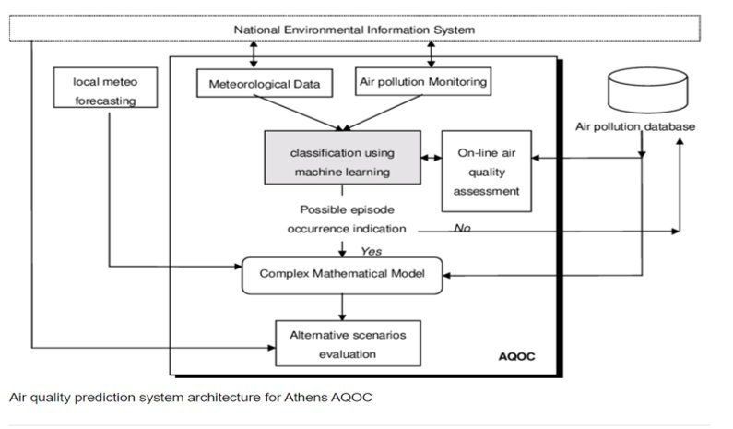
Architecture for Air Auality Analysis

Slide 17
Linear Regression
Simple linear regression is useful for finding relationship between two continuous variables. One is predictor or independent variable and other is
response or dependent variable. It looks for statistical relationship but not deterministic relationship. Relationship between two variables is said to be deterministic if one variable can be accurately expressed by the other.
Linear regression performs the task to predict a dependent variable value (y) based on a given independent variable (x). So, this regression technique finds out a linear relationship between x (input) and y(output)

Slide 18
Support Vector Machine
“Support Vector Machine” (SVM) is a supervised machine learning algorithm which can be used for both classification or regression challenges.
However, it is mostly used in classification problems. In this algorithm, we plot each data item as a point in n-dimensional space (where n is number of features you have) with the value of each feature being the value of a particular coordinate.
Pros:
It uses a subset of training points in the decision function (called support vectors), so it is also memory efficient.
Cons:
It also doesn’t perform very well, when the data set has more noise i.e. target classes are overlapping.

Slide 19
Decision Tree
Decision Tree Analysis is a general, predictive modelling tool that has applications spanning a number of different areas.
In general, decision trees
are constructed via an algorithmic approach that identifies ways to split a data set based on different conditions. It is one of the most widely used and practical methods for supervised learning.
Decision Trees are a non- parametric supervised learning method used for both classification and regression tasks. The goal is to create a model that predicts the value of a target variable by learning simple decision rules inferred from the data features.

Slide 20
A general algorithm for a decision tree can be described as follows:
Pick the best attribute/feature. The best attribute is one which best splits or separates the data.
Ask the relevant question.
Follow the answer path.
Go to step 1 until you arrive to the answer.
Pros:
Can handle both numerical and categorical data. Can also handle multi-output problems.
Cons:
Decision trees can be unstable because small variations in the data might result in a completely different tree being generated

Slide 21
SYSTEM REQUIREMENTS

Slide 22
System Requirements
Hardware Requirements
CPU: 2 x 64-bit 2.8 GHz 8.00 GT/s CPUs
RAM: 32 GB (or 16 GB of 1600 MHz DDR3 RAM)
Storage: 300 GB.
Software Requirements
Ubuntu users may need to install cURL.
Client environment may be Windows, macOS or Linux
MongoDB 2.6 (provided)
Anaconda Repository license file

Slide 23
MODULE IMPLEMENTATION AND SNAPSHOTS

Slide 24
Implementation Modules
This dataset contains the responses of a gas multisensor device deployed on the field in an Italian city. Hourly responses averages are recorded along with gas concentrations references from a certified analyzer. The dataset contains 9358 instances of hourly averaged responses from an array of 5 metal oxide chemical sensors embedded in an Air Quality Chemical Multisensor Device.

Slide 25
Importing Packages
In programming, a module is a piece of software that has a specific functionality. For example, when building a ping pong game, one module would be responsible for the game logic, and another module would be responsible for drawing the game on the screen. Each module is a different file, which can be edited separately.
Matplotlib
Matplotlib is an amazing visualization library in Python for 2D plots of arrays. Matplotlib is a multi-platform data visualization library built on.
NumPy arrays and designed to work with the broader SciPy stack.

Slide 26
Numpy
NumPy is a Python package which stands for ‘Numerical Python’. It is the core library for scientific computing, which contains a powerful n- dimensional array object, provide tools for integrating C, C++ etc. It is also useful in linear algebra, random number capability etc. NumPy array can also be used as an efficient multi-dimensional container for generic data.
Pandas
Pandas is a high-level data manipulation tool developed by Wes McKinney. It is built on the Numpy package and its key data structure is called the DataFrame . DataFrames allow you to store and manipulate tabular data in rows of observations and columns of variables.

Slide 27
Feature Selection
Feature Selection is one of the core concepts in machine learning which hugely impacts the performance of your model. The data features that you use to train your machine learning models have a huge influence on the performance you can achieve.
Feature selection and Data cleaning should be the first and most important step of your model designing.Feature Selection is the processwhere you automatically or manually select those features which contribute most to your prediction variable or output in which you are interested in.

Slide 28
Snapshot of the Implementation Modules
Month-wise plotting the influencing gases
March 2004
April 2004
May 2004
June 2004
July 2004
August 2004
September 2004
October 2004
November 2004
December 2004
January 2005
February 2005
March 2005
April 2005
Feature Selection
Column-wise Averaging

Slide 29
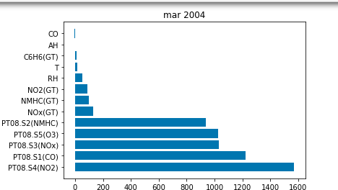
1. Month-wise Plotting the influencing gases
March 2004
This graph shows the distribution of gases of March 2004.

Slide 30
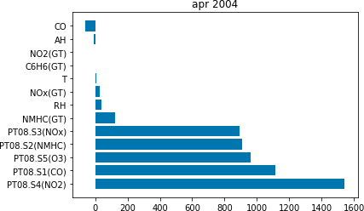
April 2004
This graph shows the distribution of gases of April 2004.

Slide 31
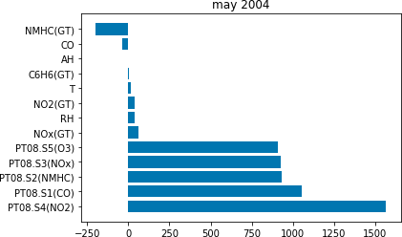
May 2004
This graph shows the distribution of gases of May 2004.

Slide 32
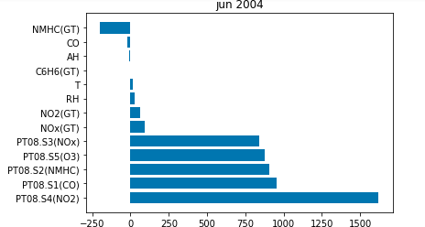
June 2004
This graph shows the distribution of gases of June 2004.

Slide 33
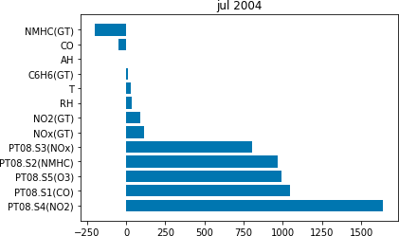
July 2004
This graph shows the distribution of gases of July 2004.

Slide 34
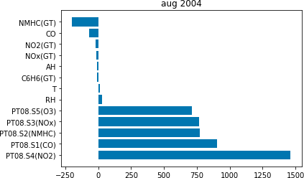
August 2004
This graph shows the distribution of gases of August 2004.

Slide 35
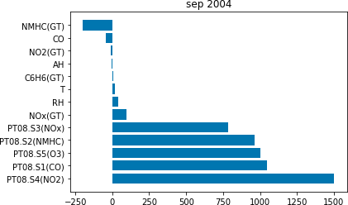
September 2004
This graph shows the distribution of gases of September 2004.

Slide 36
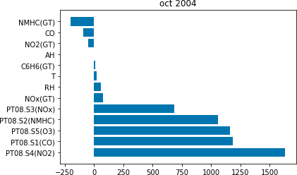
October 2004
This graph shows the distribution of gases of October 2004.

Slide 37
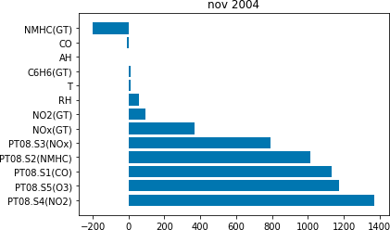
November 2004
This graph shows the distribution of gases of November 2004.

Slide 38
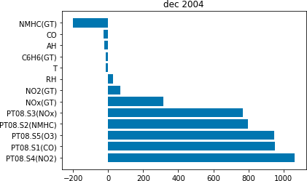
December 2004
This graph shows the distribution of gases of December 2004.

Slide 39
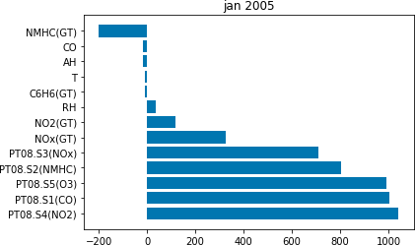
January 2005
This graph shows the distribution of gases of January 2005.

Slide 40

February 2005
This graph shows the distribution of gases of February 2005.

Slide 41
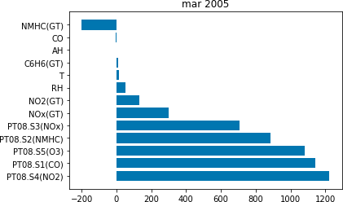
March 2005
This graph shows the distribution of gases of March 2005.

Slide 42
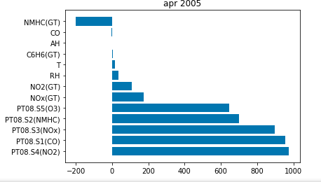
April 2005
This graph shows the distribution of gases of April 2005.

Slide 43
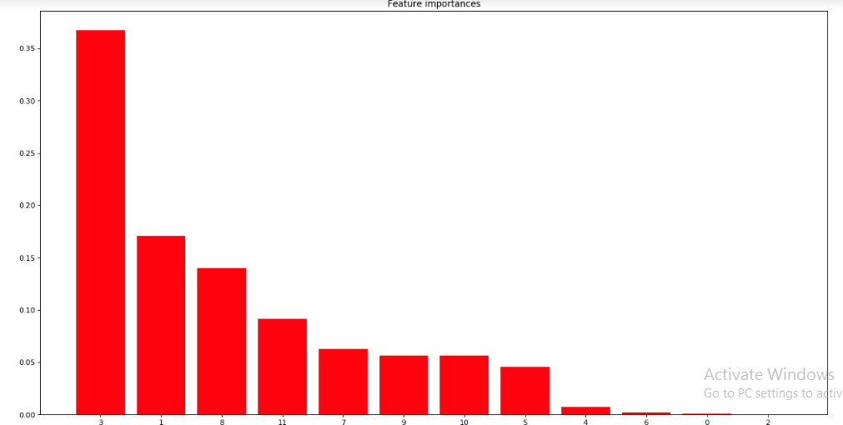
Feature Selection
This graph shows the important features from the dataset.

Slide 44
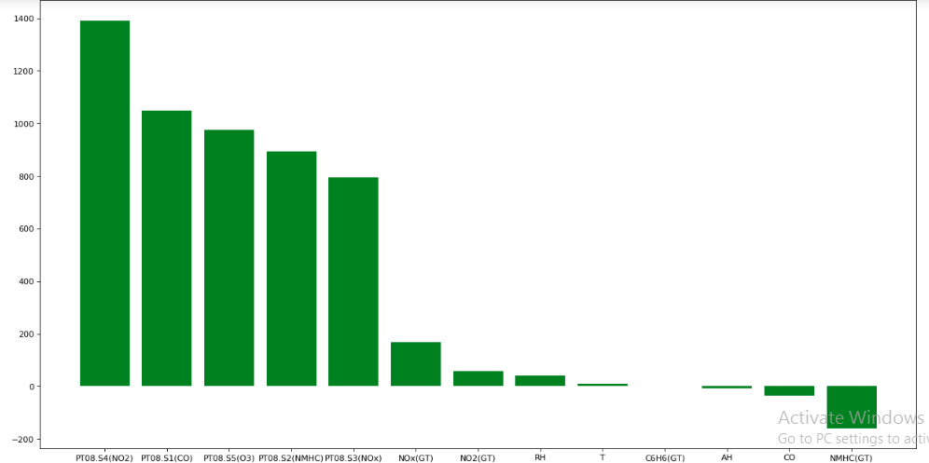
Column Averaging
This graph shows the column-wise averaging of the gases in the dataset.

Slide 45
CONCLUSION AND FUTURE WORK

Slide 46
Conclusion and Future Work
Conclusion
The air quality data generation through air quality monitoring network available today, involves large number of monitoring agencies, personal and equipment for sampling, chemical analysis and data reporting etc. The involvement of several agencies increases the probability of variations and personal biases reflecting on the data. Therefore, the air quality data statistics available today is being recognized to be more indicative rather than absolute and perfect.

Slide 47
Conclusion and Future Work
Future Work
Society looks for a pollution-free globe for happy living. The global warming threat is waiting at the door.
Government rules,governing pollution control in private sector industries are not implemented that effectively.
This scenario stresses the need for an efficient monitoring system with the collaboration of users, domain experts, hardware designers and software developers. This study is an attempt in this direction.

Slide 48
REFERENCES

Slide 49
References
Balram Pani, “Sources of Air Pollution,” in Air Pollution, Text book of Environmental Chemistry, I. K. International Publishing House Pvt. Ltd, New Delhi,(2007), PP. 197-198,.
Jane K. Hart, Kirk Martinez, “Environmental Sensor Networks: A revolution in the earth system science?,” Earth-Science reviews,( 2006) , vol. 78, PP. 177-191 .
Tamilnadu Pollution Control Board, Available: www.tnpcb.gov.in.
Narain, Cover story, “Carbon Discredit” Science and Environment fortnightly, Down To Earth, December 1,( 2008),PP. 41.

Slide 50
References contd.
Centre for Science and Environment, New Delhi, “Green Rating network,” Science and Environment fortnightly, Down To Earth, December 16, (2008), PP. 51.
Rajesh Rangarajan, “Air Quality Monitoring Regime in India an Overview,” Pollution Monitoring Series: Briefing Note 1, Centre for Development Finance, April (2010), PP. 1-11.
NAAQS Table. (2015). [Online]. Available: https://www.epa.gov/criteria-air-pollutants/naaqs-table
T. Chiwewe and J. Ditsela, “Machine learning based estimation of Ozone using spatio-temporal data from air quality monitoring stations,” presented at 2016 IEEE 14th International Conference on Industrial Informatics (INDIN), IEEE, 2016.

Slide 51
References contd. - WebLinks
https://www.wikipedia.org
https://towardsdatascience.com
https://medium.com
https://scikit-learn.org
https://en.wikipedia.org › wiki › Environmental_issues_in_India

Slide 52
Thank You

